Slide 1
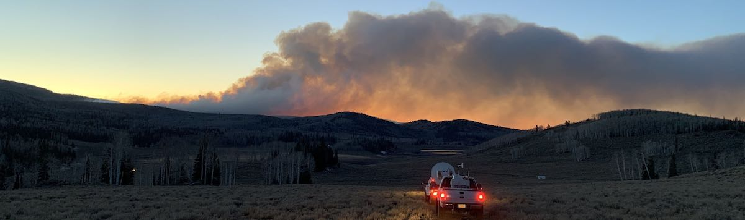
From Kalman Filters to Recurrent Neural Networks
Jan Mandel, University of Colorado Denver
Angel Farguell, San Jose State University
James Haley, Colorado State University
Kyle Hilburn, Colorado State University
Adam Kochanski, San Jose State University
Derek Mallia, University of Utah
Supported partially by NASA grant 80NSSC19K1091

Slide 2
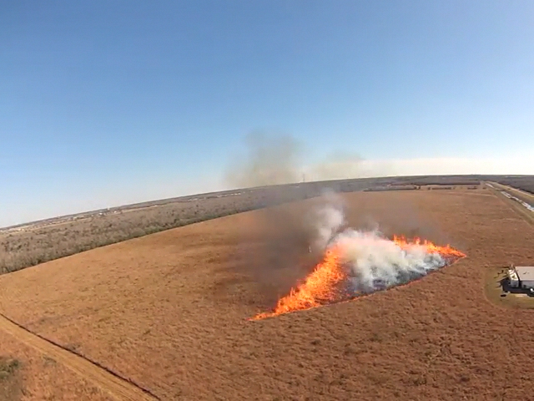
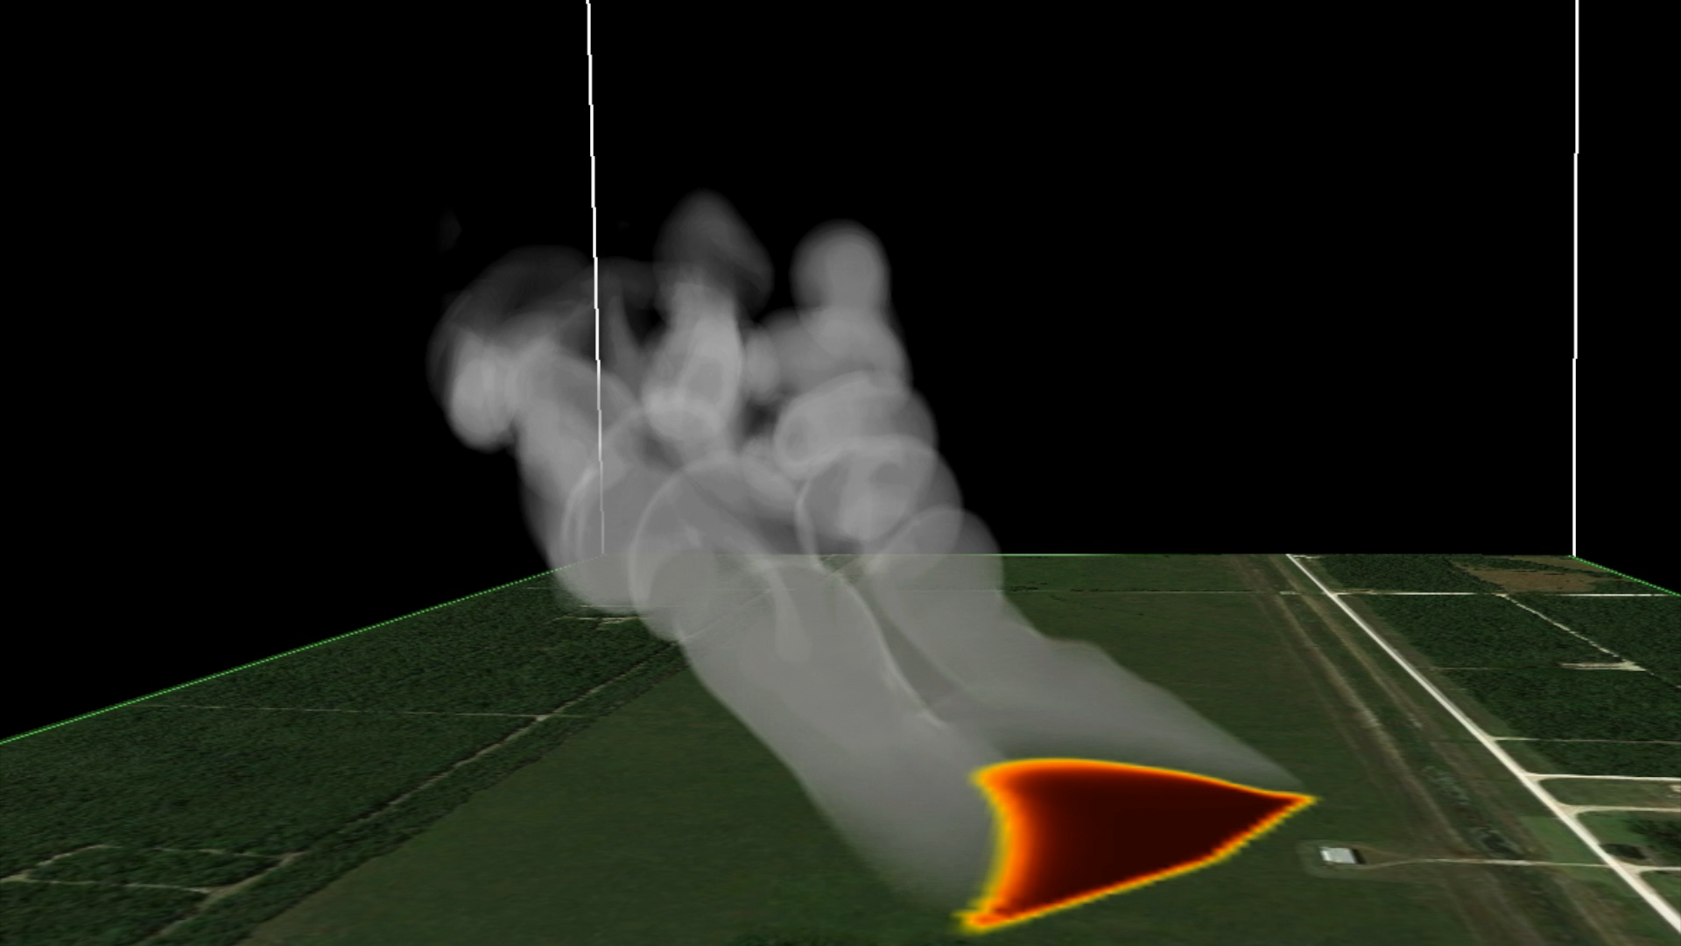
Coupled Fire-Atmosphere Modeling Example - FireFlux II Experimental Burn
Winds aloft are weaker
than at the surface
during the fire front passage
Clements et al. 2019

Slide 3
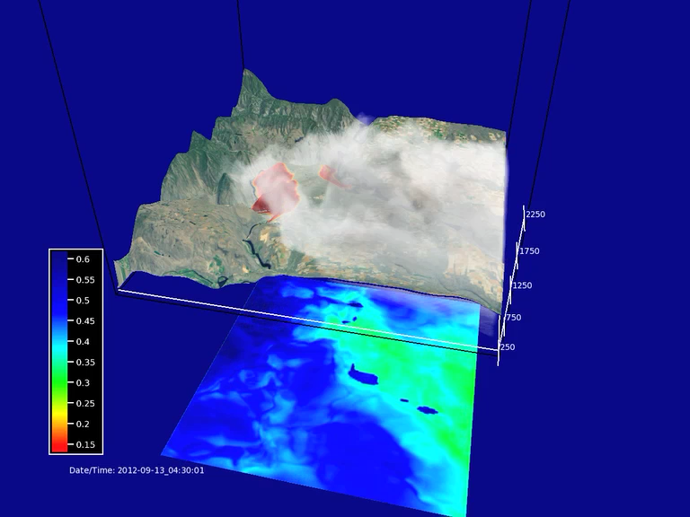
A real wildfire takes days. Coupling between weather and fuel moisture impacts fire activity.
Barker Canyon Fire (WA 2012) 29,000 acres
in-plume concentration ~3000μg /m³ (3mg/m³)
High
Fuel Moisture
Low
Fuel Moisture
Daytime warming decreases fuel moisture while nighttime cooling increases it.
Diurnal fluctuations in temperature and fuel moisture make fire active during the daytime (low fuel moisture) and stagnant during the nighttime (high fuel moisture).

Slide 4
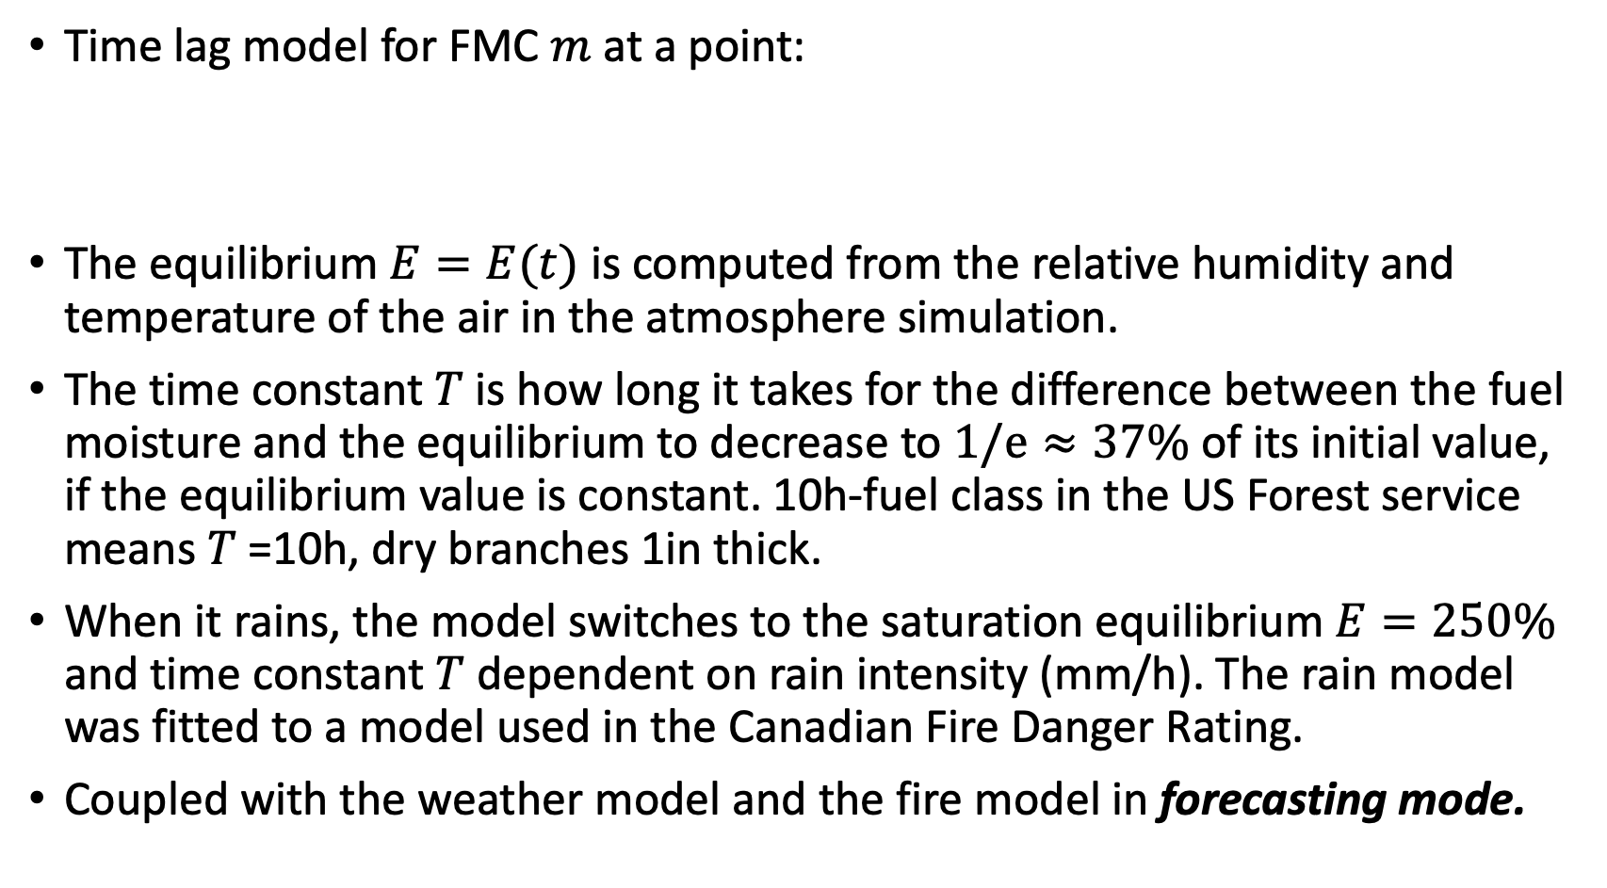
The Current Fuel Moisture Content (FMC) Model in WRF-SFIRE
Time lag model for FMC $m$ at a point:
The equilibrium $E=E(t)$ is computed from the relative humidity and temperature of the air in the atmosphere simulation.
The time constant $T$is how long it takes for the difference between the fuel moisture and the equilibrium to decrease to $1/e≈37\%$ of its initial value, if the equilibrium value is constant. 10h-fuel class in the US Forest service means $T$=10h, dry branches 1in thick.
When it rains, the model switches to the saturation equilibrium $E=250\%$ and time constant $T$ dependent on rain intensity (mm/h). The rain model was fitted to a model used in the Canadian Fire Danger Rating.
Coupled with the weather model and the fire model in forecasting mode.

Slide 5
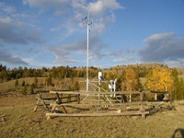
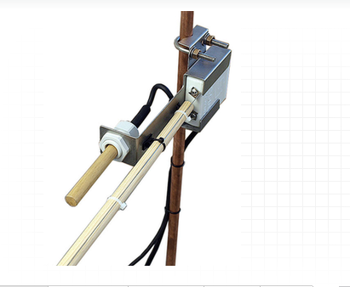
Fuel Moisture Contents (FMC) Measurements
Remote Automated Weather Stations (RAWS) in the Western US measure the 10-hour FMC fuel every hour and transmit the data by a satellite uplink.
Data are available online.

Slide 6
How we are using the RAWS FMC data now
Inputs every hour:
The RAWS FMC every hour – in training mode only
The atmosphere (temperature, relative humidity, rain)
In training mode from historical or near real-time weather products
In prediction mode, from weather prediction
State passed from every hour to the next hour:
The fuel moisture contents - 1 number
Parameter corrections – moisture equilibria from textbooks are wrong – 1 number
Uncertainty – in Kalman filter, the state covariance = symmetric 2x2 matrix = 3 numbers
The Kalman filter splits the difference between the observation data and the model, and also evolves an estimate of the uncertainty of the model (the covariance matrix)
This is very simplified – an estimate in time only. See the paper for a complete method with estimate in both time and space from the RAWS network and weather.
Animated maps at https://demo.openwfm.org
Martin Vejmelka, Adam K. Kochanski, and Jan Mandel. Data assimilation of dead fuel moisture observations from remote automatic weather stations. International Journal of Wildland Fire, 25:558– 568, 2016.

Slide 7
Training and prediction with Kalman Filter
RTMA
RTMA
WRF
WRF
Atmosphere
state
Atmosphere
state
Atmosphere
state
Atmosphere
state
FMC Model
Kalman Filter
FMC Model
Kalman Filter
FMC Model
FMC Model
state
state
state
state
state
FMC output
FMC output
FMC output
FMC output
Error
Error
RAWS
FMC Data
RAWS
FMC Data
Training time
Prediction time
The “state” here is all passed to the next time period – including quantified uncertainty (here, covariance)

Slide 8
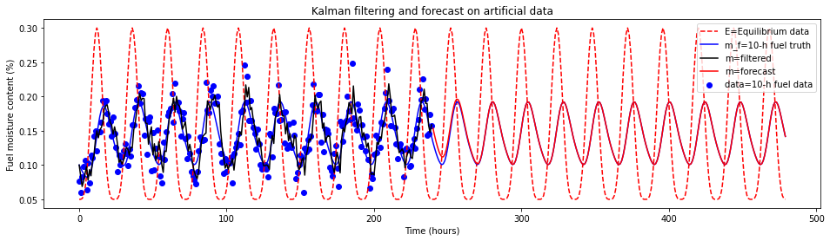
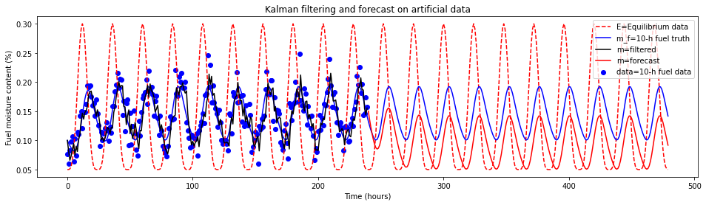
Model with Kalman Filter, artificial data
When the model is accurate:
When the FMC equilibrium has a bias (the books are wrong):

Slide 9
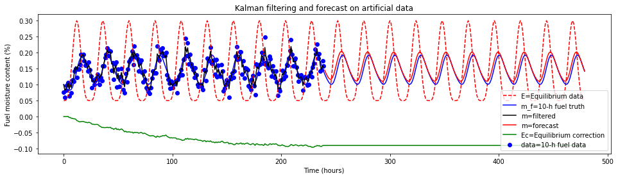
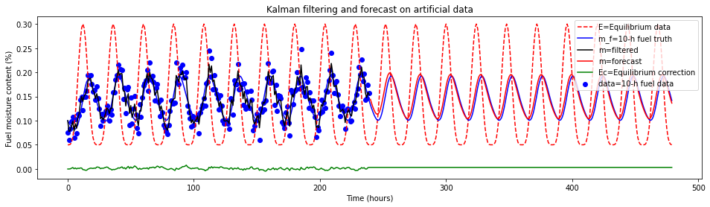
Kalman filter with augmented state
Bias correction:
No bias, no correction needed:

Slide 10
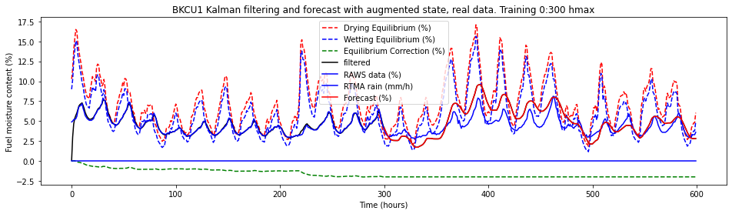
Augmented Kalman Filter on Real Data
Training (a.k.a. filtering and parameter estimation) looks fine, but then the errors get larger. Why?
The moisture contents in the wooden stick is not the same everywhere as the simple ODE model assumes. Multiple layer models exist.
A single bias correction is too simple. More parameters to identify.
Modeling gets complicated.
Build a model from data instead.

Slide 11
From Kalman Filter to a Recurrent Neural Network
RTMA
RTMA
WRF
WRF
Atmosphere
state
Atmosphere
state
Atmosphere
state
Atmosphere
state
Operator
Operator
Operator
Operator
Recurrent neural network
Recurrent neural network
Recurrent neural network
Recurrent neural network
FMC Model
Kalman Filter
FMC Model
Kalman Filter
FMC Model
FMC Model
state
state
state
state
state
FMC output
Fitting
FMC output
Fitting
FMC output
FMC output
Error
Error
RAWS
FMC Data
RAWS
FMC Data
Training time
Prediction time
The “state” here is all passed to the next time period, including quantified uncertainty – whatever the trained RNN does

Slide 12
Creating and training the network
First try: Layers, many neurons, tanh activation….
But training just won’t converge to a reasonable solution.
Solution: Start simple, find initial weights so that the network solves a basic case of the differential equation. Program the basic differential equation model as neural network. Then increase the layers sizes and let it train to reality.

Slide 13
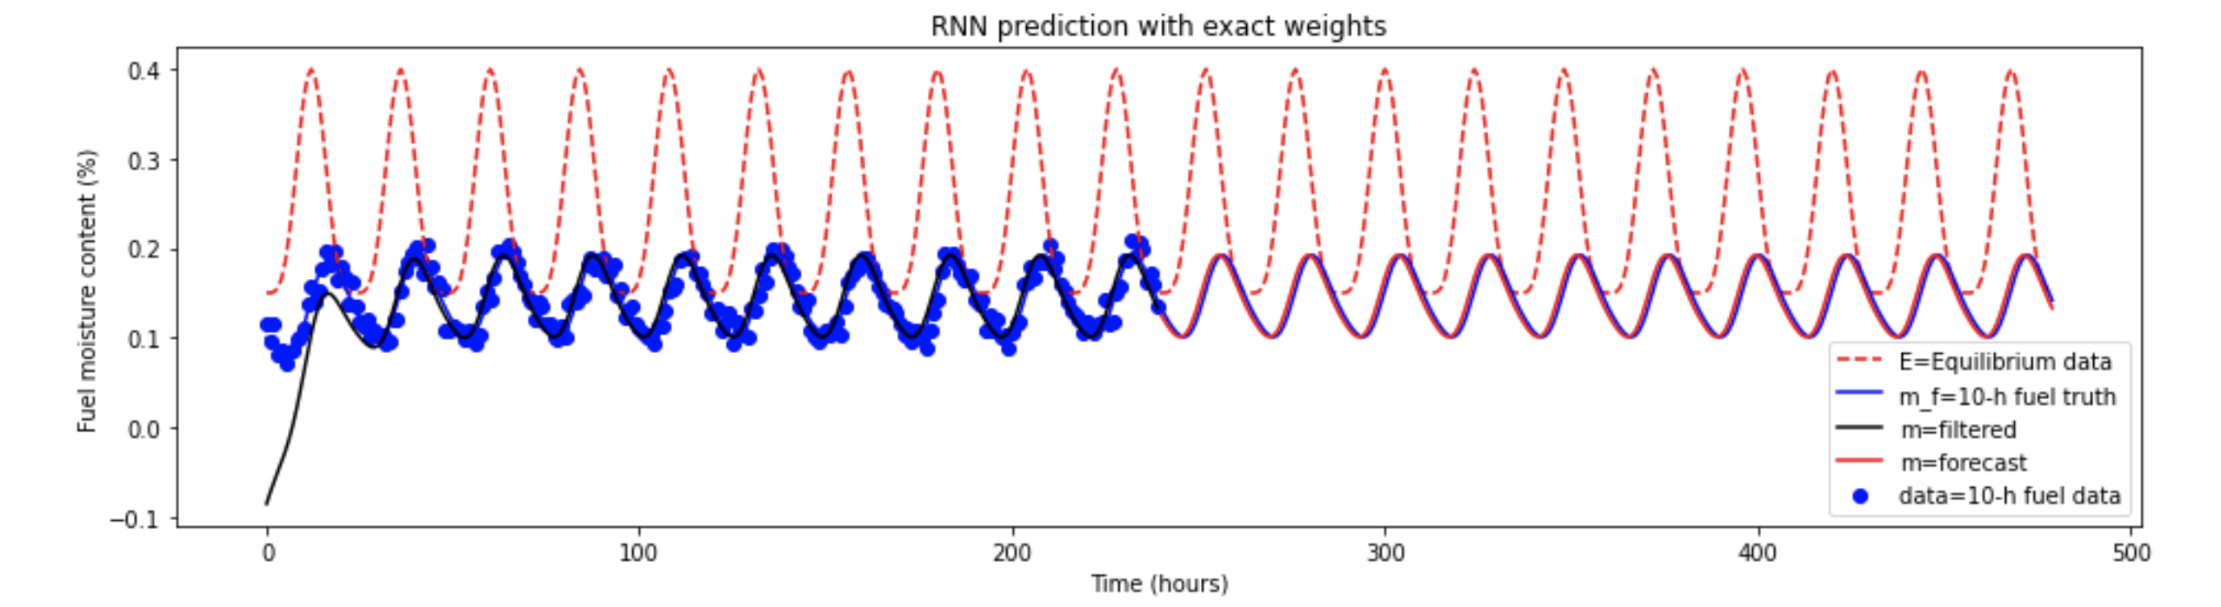
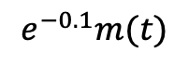
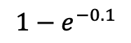
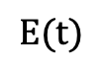
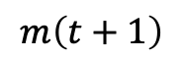
A simple RNN which solves the differential equation
with $T=10⟹ m\left(t+1\right)≈e^{−0.1}m(t)+\left(1−e^{−0.1}\right)E(t)$ exact if E is constant
Hidden state
and output
Input
$$e^{−0.1}m(t)$$
Linear
activation
The solution continues following the equilibrium
Training converges, the equilibrium bias and the time constant are learned as weights from the data.
Regularization is from the simplicity of the network
For real data, add RNN cells and a dense layer
$$E(t)$$
$$1−e^{−0.1}$$
$$m\left(t+1\right)$$
Single neuron = number of hidden units = the recurrent state dimension = 1

Slide 14
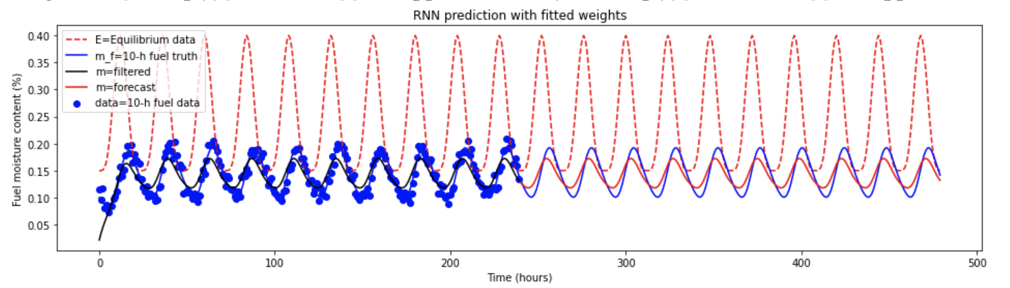
RNN on synthetic data
Single neuron = number of hiden units = the recurrent state dimension = 1

Slide 15
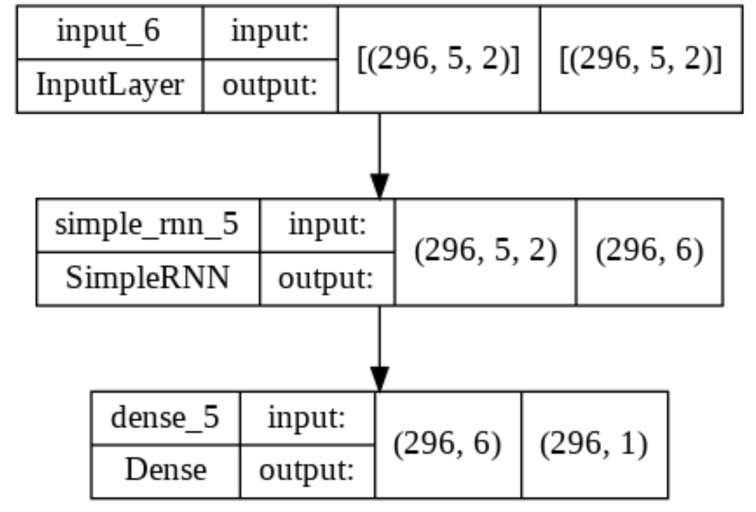
Real RNN
2 input numbers = drying and wetting equilibria
Recurrent: feed output back to a second input
Consolidate the outputs to one number to compare with data in training phase
Number of hidden units = the recurrent state dimension = 6

Slide 16
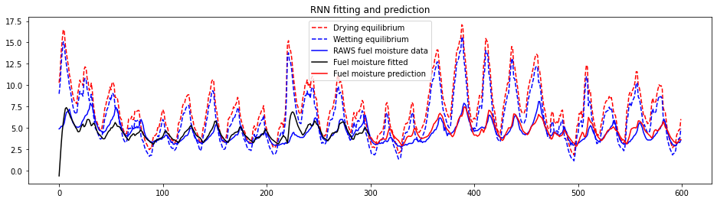
Real data
number of hidden units = the recurrent state dimension = 6

Slide 17
Thank you!

